Slide 1
E-SHOPPING SYSTEM
DONE BY
S.PRANAY(192011407)

Slide 2
AIM:
To perform testing and identifying positive and negative test case scenarios on purchase module for e-shopping system(amazon).
And also to perform testing and identifying positive and negative test cases scenarios on delivery module for e-shopping system(amazon).

Slide 3
TEST CASE SCENARIOS FOR PURCHASE MODULE:
Confirm if the item is added to the cart.
Confirm if the quantity is as expected for the order.
Confirm if the delivery charges are added to the cart page.
Check the amount payable is correct.
Check if the cart has the place order and continue shopping buttons.
Check if the shopping cart shows the total savings amount.
Check the delivery date of the item.

Slide 4
Verification that delivery location should be shown on the cart page.
Verify right items are displayed on the cart page.
Verify that option is available to increment or decrement the number of items.
Verify the option to delete the item is available.
Verify offers section should be displayed.
Verify offer should be applied successfully when the user applies one offer.
Verify option to tip your valet should be available.
Verify the invoice should be generated correctly.
Verify there is an option to ad voice directions.
Verify delivery location can be changed.
Verify when the delivery location is changed and if the delivery location is not serviceable then an error message should be shown.
Verify your details should be shown.
Verify there should be an option to order for someone else.
Verify pay using option should be shown.
Verify upon clicking of pay now, different payments options should open.
Verify different payment options should work correctly.
Verify cart page can be minimized.
Verify cart should retain the products even if the app is closed.
Verify upon adding another item from the different restaurant the earlier item should be removed automatically.

Slide 5
Verify that on the product page, the user can select the desired attribute of the product e.g. size, color, etc.
Verify that the user can add to cart one or more products.
Verify that users can add products to the wishlist.
Verify that the user can buy products added to the cart after signing in to the application (or as per the functionality of the website).
Verify that the user can successfully buy more than one product that was added to his/her cart.
Verify that the user cannot add more than the available inventory of the product.
Verify that the limit to the number of products a user can by is working correctly by displaying an error message and preventing the user from buying more than the limit.
Verify that the delivery can be declined for the places where shipping is not available.
Verify that the Cash on Delivery option of payment is working fine.
Verify that the different pre-paid methods of payments are working fine.
Verify that product return functionality works fine.

Slide 6
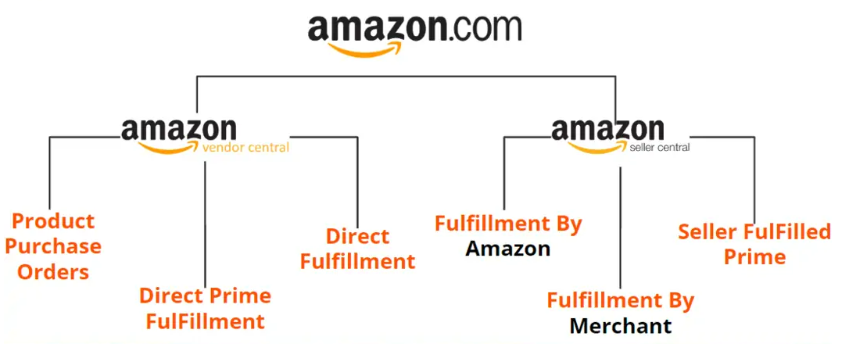

Slide 7
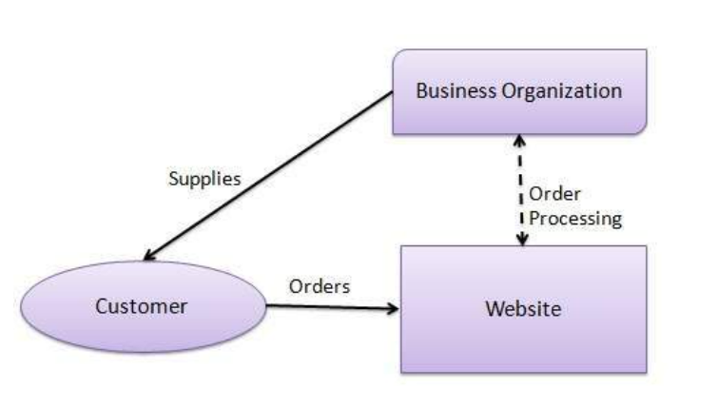

Slide 8
Test cases for delivery module:
Installing and updating of delivery application,
All fields and functionalities should work as per requirements,
The behaviour of the application when there is a new message or phone call
Behaviour of the application when there is a lack of internet
Verification of error messages when something is wrong with order delivery application
Verification that the application should not consume too much memory and space, etc.

Slide 9
ADDRESS OF THE CUSTOMER:
NAME:
ADDRESS:
STREET/COLONY:
HOUSE NO:
NEAR BY:
PHONE NO:
ADD PHONE NO:

Slide 10
ORDER TRACKING:
Ordered successfully.
Order out of state.
Order shipped.
Out of delivery.
Order yet to be deliver.
Order delivered successfully.

Slide 11
CONCLUSION:
Now, you must be aware of testing plans for a order delivery application such as amazon . Testing for an online order delivery system is easy but should be performed carefully. Contact us to know more if you still have doubts about delivery app testing.

